Slide 1
Complex Medical Claims
OHFT CMCoE Team
March 2025

Slide 2
Complex Medical Claims – On-Prem Assessment
Complex Medical Conditions (CMC) is a suite of applications designed for insurance providers, employers, and users.
Timelines: Start: Feb 2025 | End: Mar 2025
Migration Observations and Gaps
Recommendations
Risk
Type | Observation
App Architecture | The application's dependency on sticky sessions limits scalability and impact reliability. Tomcat and Apache HTTPD upgrades are done by the application team. The configurations are neither version-controlled nor properly maintained, posing operational risks. Modernizing Application Architecture with cloud native adoption framework, would bring in 30-50% reduction in TCO and optimized performance.
Data Management | Microsoft SQL Server 2019 enters the Extended Support phase in February 2025. The lack of data retention and archival policy results in linear or even exponential database growth. Uncontrolled data expansion poses risks to application performance and user experience.
Security & Compliance | CMC applications handle PHI and PII data and must adhere to HIPAA compliance standards. The system undergoes enterprise-level vulnerability scanning and code-level security scans. There is no available information on network-level or application-level penetration testing, posing potential security risks.
Business Continuity | DR is handled by enterprise IT team and DR exercise reports are available.
All six CMC applications should be containerized and deployed to Azure Kubernetes Service (AKS).
Shared session management should be implemented, eliminating the need for sticky sessions.
The self-managed Microsoft SQL Server should be migrated to a managed SQL Server instance.
Regular backups should align with Recovery Point Objectives (RPO) to prevent data loss.
Establish dedicated VNets for production and non-production environments.
Integrate Azure Load Balancer, Azure Front Door, and Web Application Firewall (WAF) to improve traffic distribution, security, and global reachability.
When migrating CI/CD to GitHub Actions Workflow, it is essential to use self-hosted runners with a dedicated pool for production jobs to maintain strict separation.
Network level and application-level penetration testing should be performed periodically.
Define data retention policies to purge or archive old data, reducing storage growth and improving system performance.
Proper data retention will also help minimize legal liabilities associated with PII, ensuring compliance with regulatory requirements.
Batch jobs and Oracle database being retained in On-Perm will require network connectivity and file sharing between cloud and On-Perm.
Tech Stack
Apache Tomcat, Apache HTTPD, IBM Global Security Kit, IBM Workload Scheduler, MSSQL, Oracle, Java, Spring, JSP, CSS, and Javascript.
RASP Recommendations
Reliability – High Availability and Plan for BC/DR​
Availability – Recommended 99.95% or up​
Scalability – Elastic and size up based on cloud demands. ​
Performance – Secure performance benchmark numbers from private cloud to plan public cloud sizing
Overall | Data Management | Security & Compliance | Business Continuity | Cloud Readiness | Cost Management | App Architecture
Notes:
Details on Scoring
Overall: Dependent on solution for GCP connectivity to on prem for BH Shared Gateway
Data Management: Replatforming to GCP Cloud SQL, required connectivity to on prem
Security & Compliance
Business Continuity: Missing DR plan
Cloud Readiness: Use of UCP v1 may require an upgrade soon.
Cost Management: N/A
Migration Process: Migration plan exists, but with some gaps

Slide 3
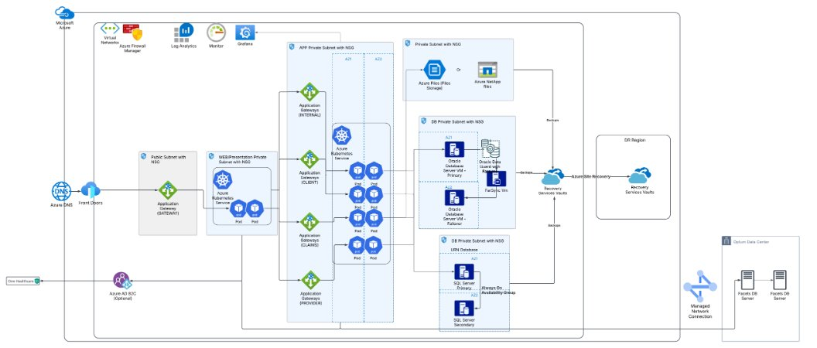
Complex Medical Claims – Target State
Overall | Data Management | Security & Compliance | Business Continuity | Cloud Readiness | Cost Management | App Architecture
Notes:
Details on Scoring
Overall: Dependent on solution for GCP connectivity to on prem for BH Shared Gateway
Data Management: Replatforming to GCP Cloud SQL, required connectivity to on prem
Security & Compliance
Business Continuity: Missing DR plan
Cloud Readiness: Use of UCP v1 may require an upgrade soon.
Cost Management: N/A
Migration Process: Migration plan exists, but with some gaps

